Slide 1
Problem Statement
Education is important to a country because it improves stability, provides better opportunity and boosts the economy. SAT and ACT are used for college admission decisions. Tertiary education being one of the key factors affecting the employability and the future of a person, Department of Education is performing analysis on the country's SAT and ACT results to determine which of the states require more resources allocation and focus.

Slide 2
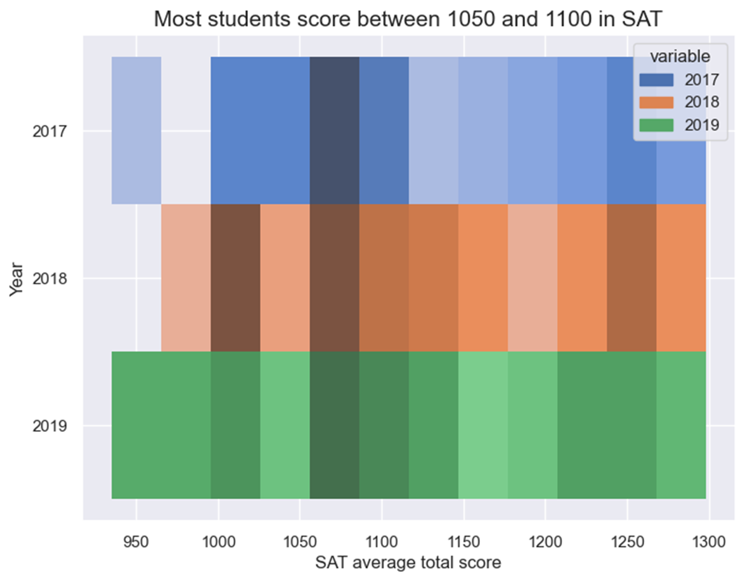

Slide 3
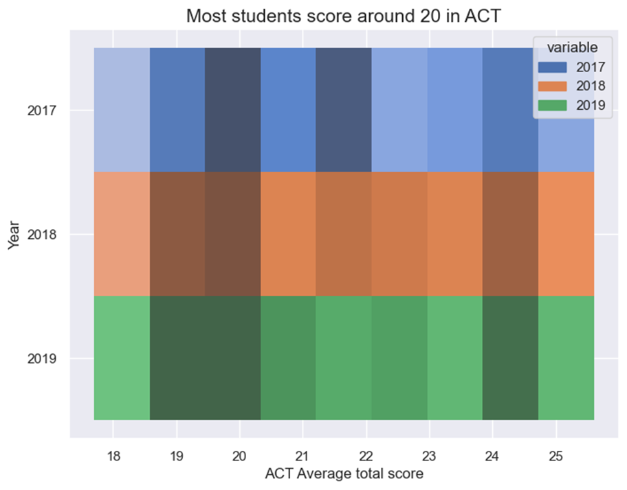

Slide 4
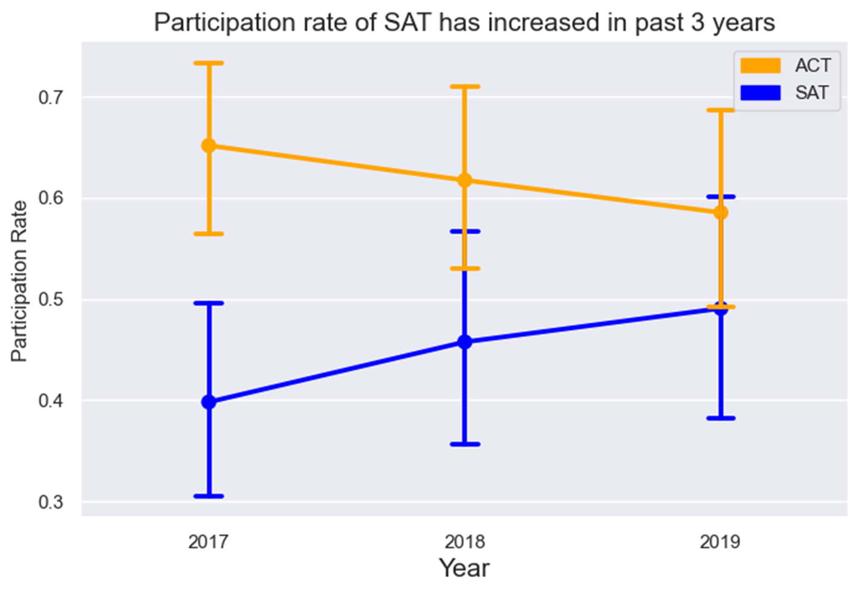

Slide 5
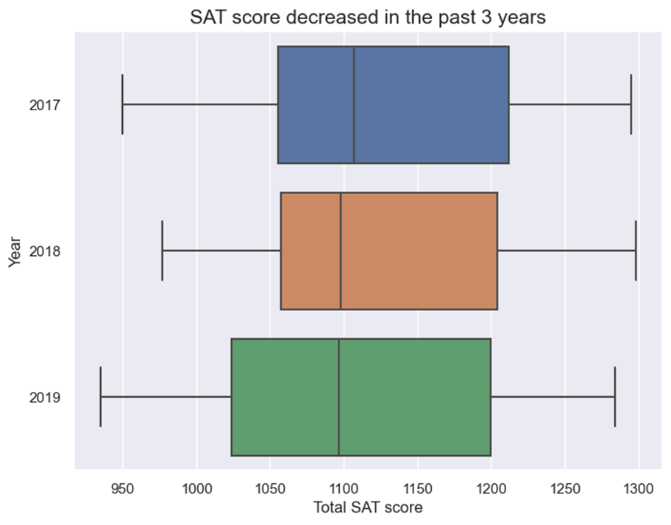

Slide 6
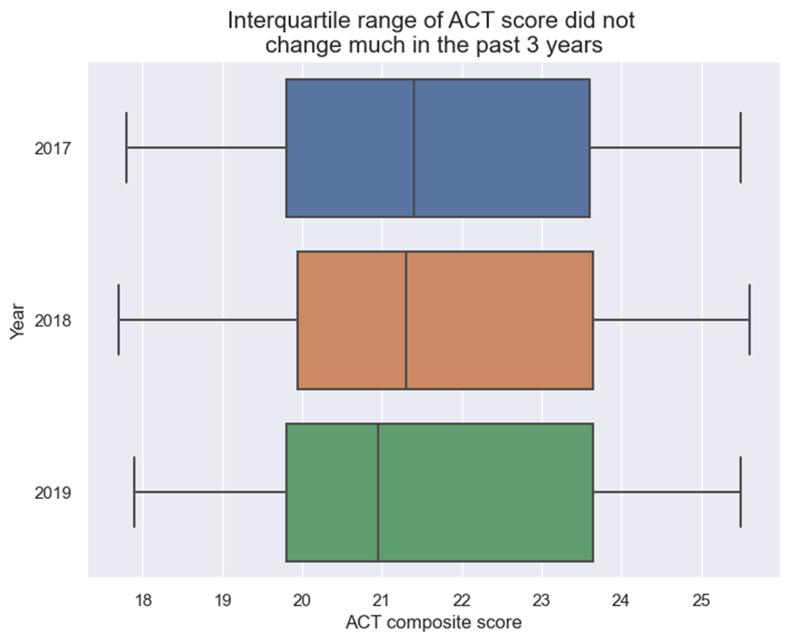

Slide 8
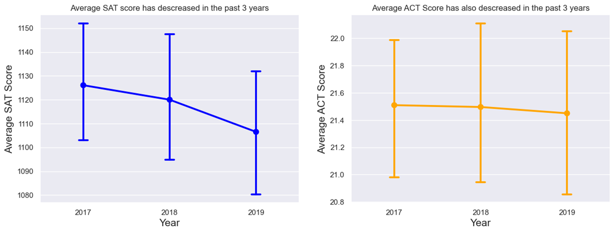

Slide 9
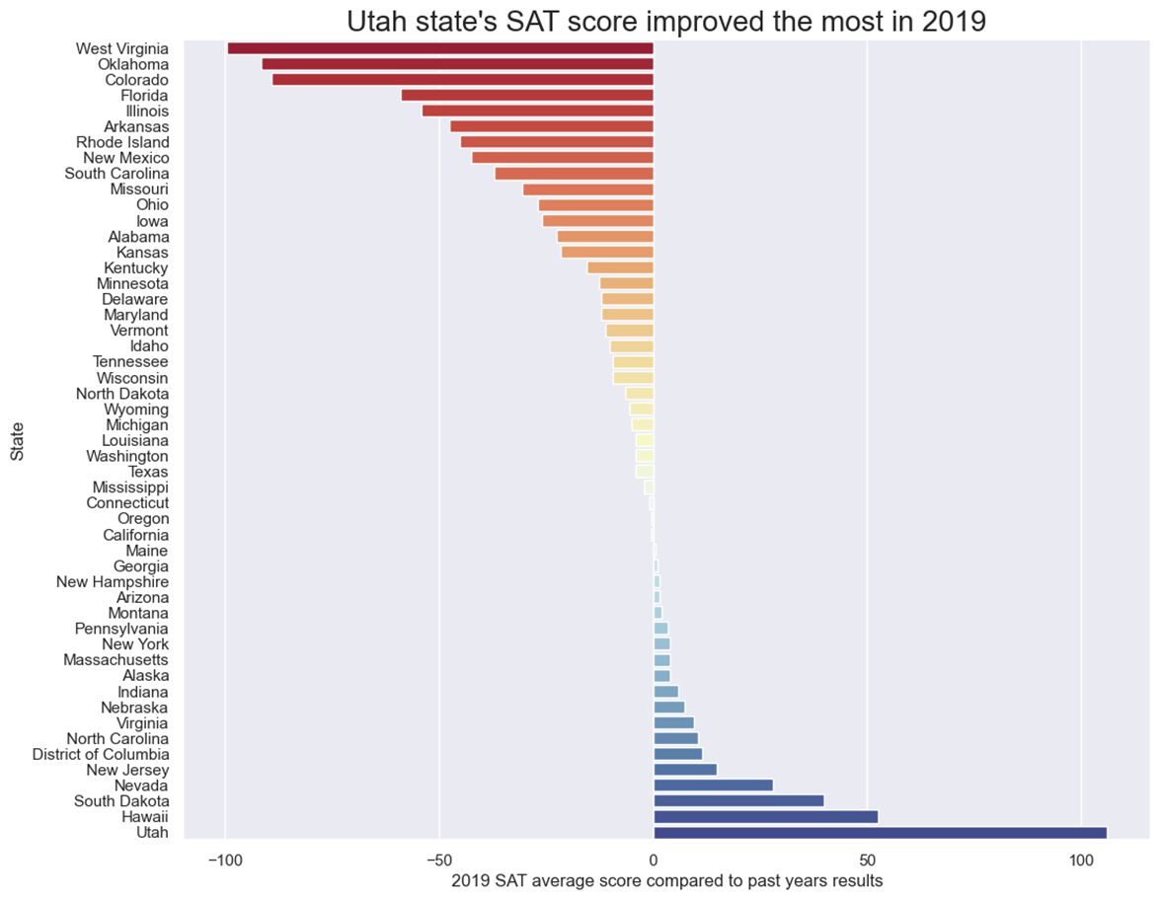

Slide 10
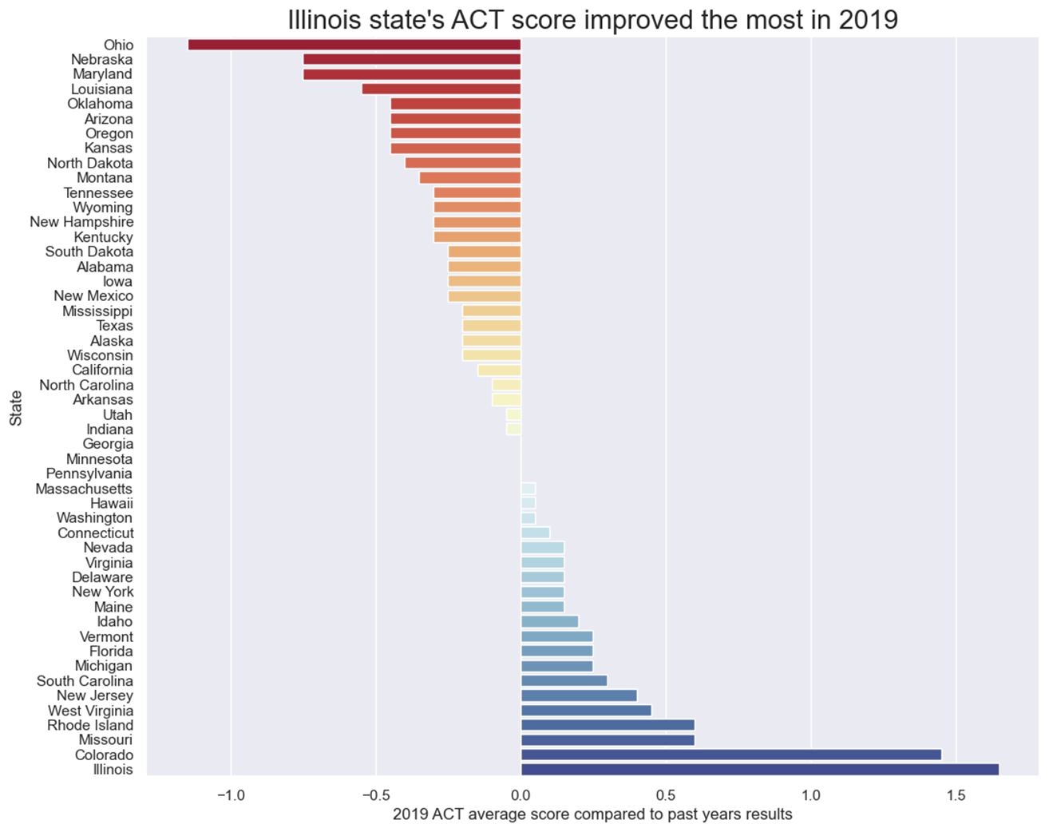

Slide 11
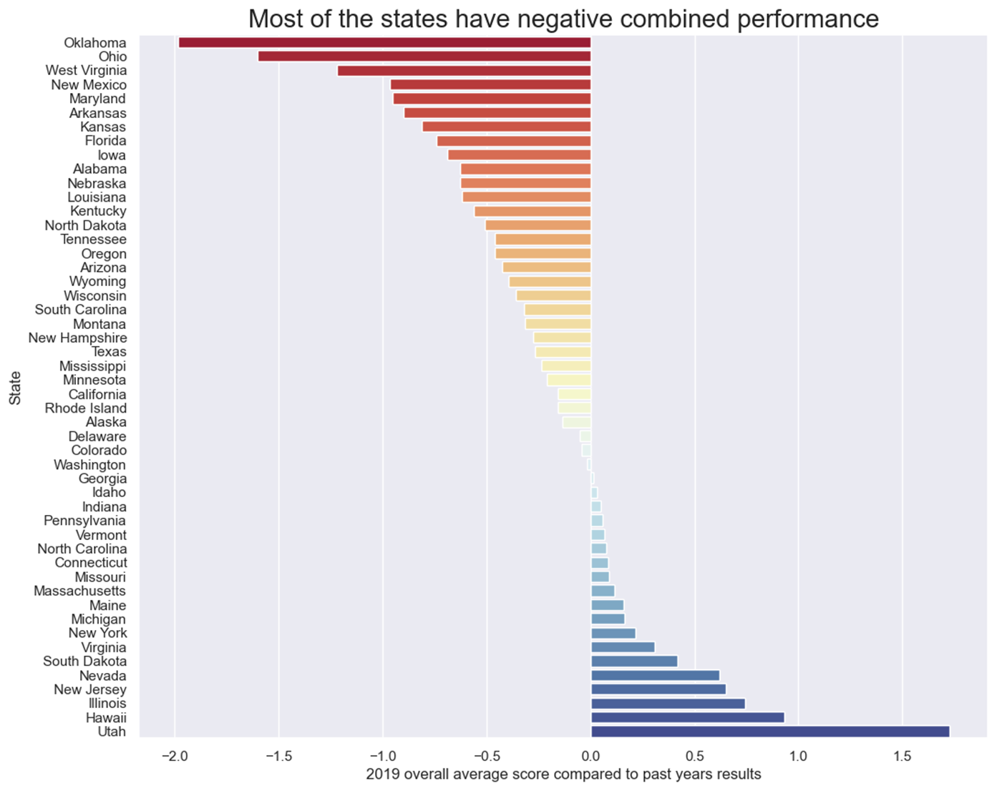

Slide 12
Conclusion
Ideally we would want to put in effort in every state to improve the overall results of the country. However, due to resources constraint, it is advised to focus more of the resources on Oklahoma, Ohio and West Virginia to prevent the results in these states get worsen.

Slide 13
THANK YOU
Prepared by:
Jance Ng
Jin Min Wood
Adrian Kong

